Slide 1
Ride fare dataset

Slide 2
Agenda
Introduction
Data cleaning
EDA

Slide 3
Introduction

Slide 4
This dataset contains detailed records of ride service transactions, including key information such as pickup and dropoff locations, fare amounts, passenger counts, timestamps, and various contextual factors like traffic conditions, weather, and car condition. It has been prepared for the purpose of analyzing and modeling fare prediction in urban transportation systems.

Slide 5
Data Cleaning

Slide 6
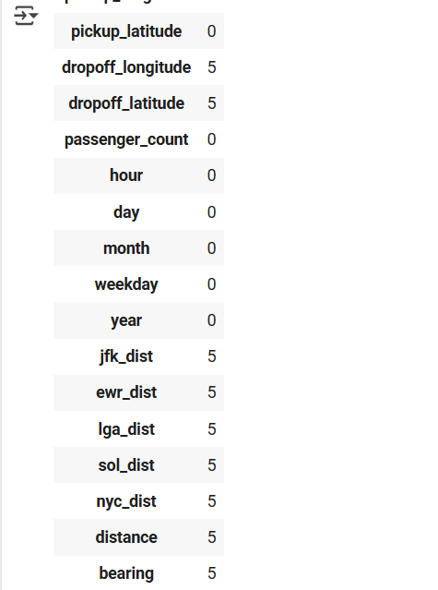
Using df.isnull().sum() showed me the number of nulls in the data set df.dropna(inplace=True)
Using this to remove the nulls

Slide 7
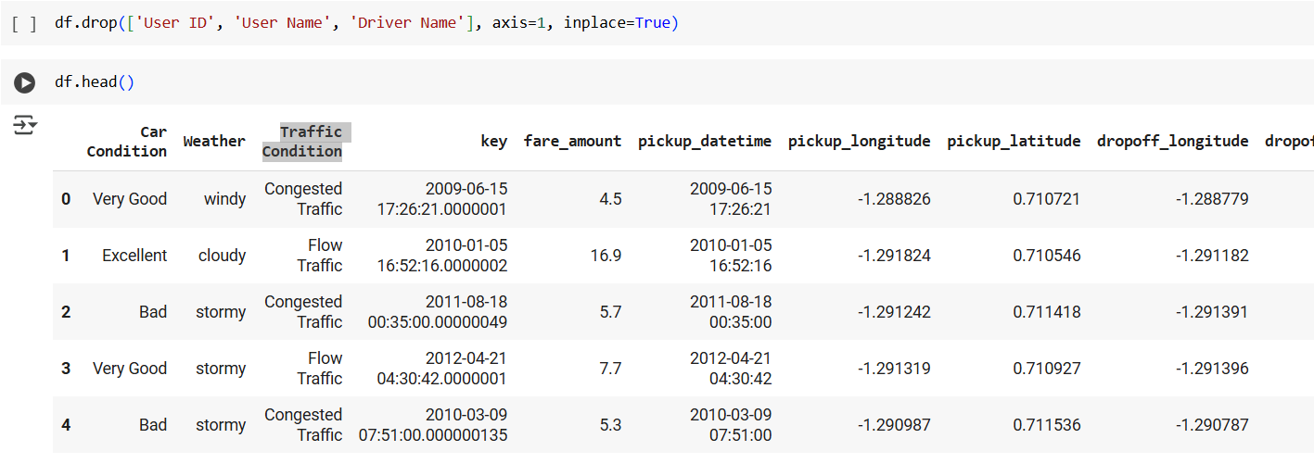
Dropped the data that will be irrelevant in the EDA
Know your material in advance
Anticipate common questions
Rehearse your responses

Slide 8
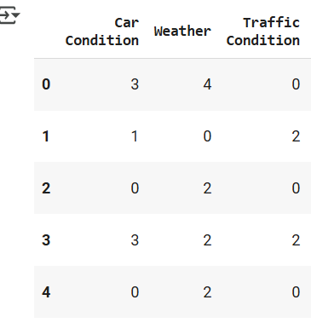
Converting categorical data
from sklearn.preprocessing import LabelEncoder
le = LabelEncoder()
df['Car Condition'] = le.fit_transform(df['Car Condition'])
df['Weather'] = le.fit_transform(df['Weather'])
df['Traffic Condition'] = le.fit_transform(df['Traffic Condition'])

Slide 9
EDA

Slide 10
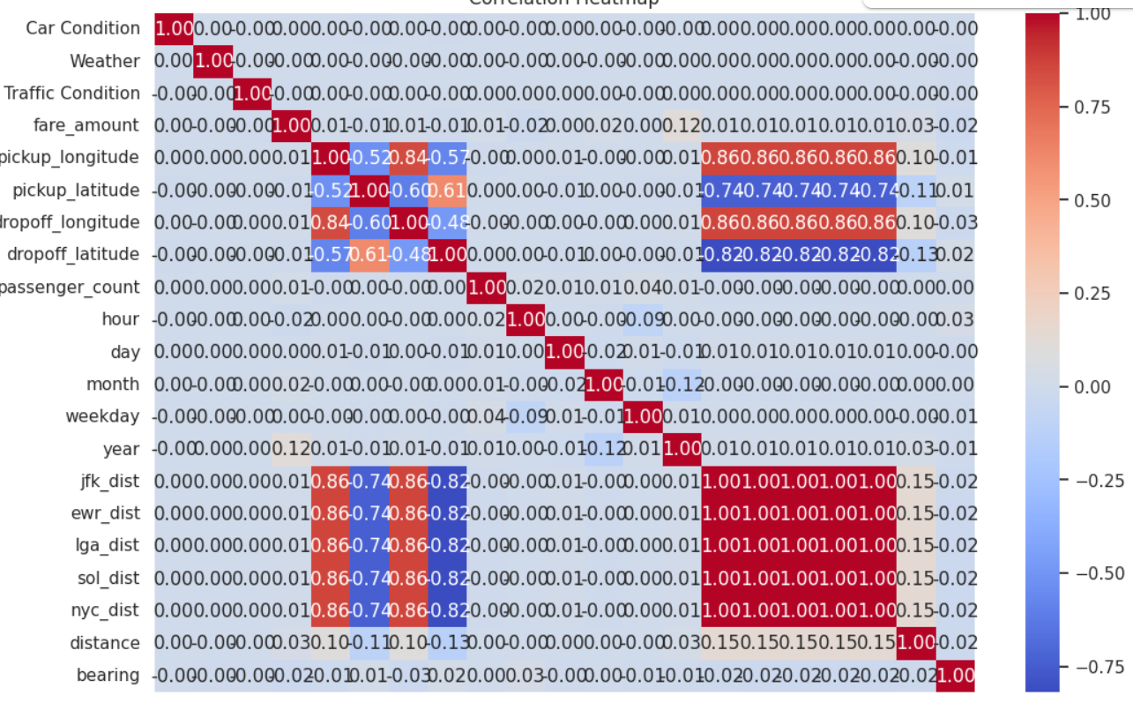
Correlation between and ride features
correlation = df.corr(numeric_only=True)['fare_amount'].sort_values(ascending=False)
print(correlation)
plt.figure(figsize=(12, 8))
sns.heatmap(df.corr(numeric_only=True), annot=True, cmap='coolwarm', fmt=".2f")
plt.title('Correlation Heatmap')
plt.show()
The strongest correlation is between the fare amount and distance

Slide 11
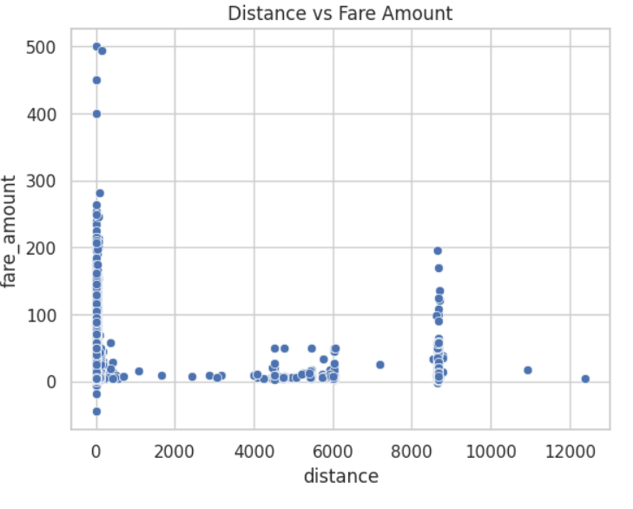
Visualisation of fare amount against distance
There are a lot of fare amounts at zero distance which means that the quality of data is not the best

Slide 12
Thank you
Sara Saeed Saad Hafez Ahmed Mamdouh Hassan

